Slide 1
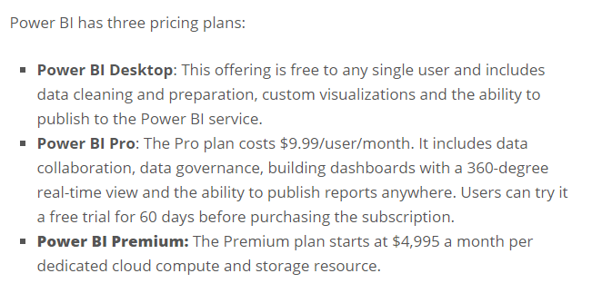
Power BI Pricing plans

